Slide 1
Table of Contents
Introduction to JavaScript Development
The Magic of Dynamic Web Pages
Dynamic HTML
How to Create DHTML?
XHTML, CSS, JavaScript, DOM
Intro to JavaScript
JavaScript in Web Pages
JavaScript Syntax
Pop-up boxes
Debugging in JavaScript

Slide 2
Dynamic HTML
Dynamic Behavior at the Client Side

Slide 3
What is DHTML?
Dynamic HTML (DHTML)
Makes possible a Web page to react and change in response to the user’s actions
DHTML consists of HTML + CSS + JavaScript
DHTML
XHTML
CSS
JavaScript
DOM

Slide 4
DTHML = HTML + CSS + JavaScript
HTML defines Web sites content through semantic tags (headings, paragraphs, lists, …)
CSS defines 'rules' or 'styles' for presenting every aspect of an HTML document
Font (family, size, color, weight, etc.)
Background (color, image, position, repeat)
Position and layout (of any object on the page)
JavaScript defines dynamic behavior
Programming logic for interaction with the user, to handle events, etc.

Slide 5
JavaScript
Dynamic Behavior in a Web Page
JavaScript is a front-end scripting language developed by Netscape for dynamic content
Lightweight, but with limited capabilities
Can be used as object-oriented language
Embedded in your HTML page
Interpreted by the Web browser
Client-side, mobile and desktop technology
Simple and flexible
Powerful to manipulate the DOM

Slide 6
JavaScript Advantages
JavaScript allows interactivity such as:
Implementing form validation
React to user actions, e.g. handle keys
Changing an image on moving mouse over it
Sections of a page appearing and disappearing
Content loading and changing dynamically
Performing complex calculations
Custom HTML controls, e.g. scrollable table
Implementing AJAX functionality

Slide 7
What Can JavaScript Do?
Can handle events
Can read and write HTML elements and modify the DOM tree
Can validate form data
Can access / modify browser cookies
Can detect the user’s browser and OS
Can be used as object-oriented language
Can handle exceptions
Can perform asynchronous server calls (AJAX)

Slide 8
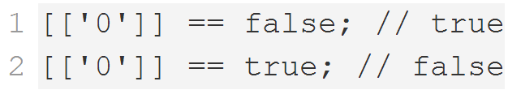
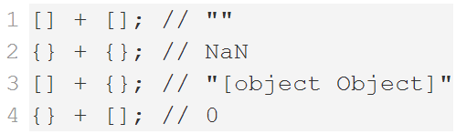
JavaScript Engines
Depends on Browser
V8 in Chrome, Chakra in IE, Spidermonkey in Firefox, JavaScriptCore for Safari, etc.
Services
Memory Management / GC
Just-in-Time Compilation
Type System
etc.

Slide 9
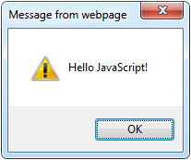
The First Script
<html>
<body>
<script type="text/javascript">
alert('Hello JavaScript!');
</script>
</body>
</html>
First JavaScript – Live Demo

Slide 10
Using JavaScript Code
The JavaScript code can be placed in:
<script> tag in the head
<script> tag in the body - not recommended
External files, linked via <script> tag the head
Files usually have .js extension
Highly recommended
The .js files get cached by the browser
<script src="scripts.js" type="text/javscript">
<!– code placed here will not be executed! -->
</script>

Slide 11
JavaScript – When is Executed?
JavaScript code is executed during the page loading or when the browser fires an event
All statements are executed at page loading
Some statements just define functions that can be called later
No compile time checks
Function calls or code can be attached as "event handlers" via tag attributes
Executed when the event is fired by the browser
<img src="logo.gif" onclick="alert('clicked!')" />

Slide 12
Calling a JavaScript Function from Event Handler – Example
<html>
<head>
<script type="text/javascript">
function test (message) {
alert(message);
}
</script>
</head>
<body>
<img src="logo.gif"
onclick="test('clicked!')" />
</body>
</html>
Event Handlers – Live Demo

Slide 13
Using External Script Files
Using external script files:
External JavaScript file:
<html>
<head>
<script src="sample.js" type="text/javascript">
</script>
</head>
<body>
<button onclick="sample()" value="Call JavaScript
function from sample.js" />
</body>
</html>
external-JavaScript.html
The <script> tag is always empty.
function sample() {
alert('Hello from sample.js!')
}
sample.js
External JavaScript Files – Live Demo

Slide 14
Node.js Overview
Node.js
Running JavaScript in a console
Node.js is a server-side platform that uses JavaScript
Runs the V8 JS interpretour
Allows creating end-to-end apps with JavaScript
Usable to test & learn JavaScript Syntax

Slide 15
Installing Node.js
Visit the Node.js website: https://nodejs.org/
Next -> Next -> Next -> …
Make sure Node.js is added to PATH
Node.js is installed on the machine and can be used through the CMD/Terminal
In the CMD/Terminal run "node –v"
Should return the version, if node is installed and working

Slide 16
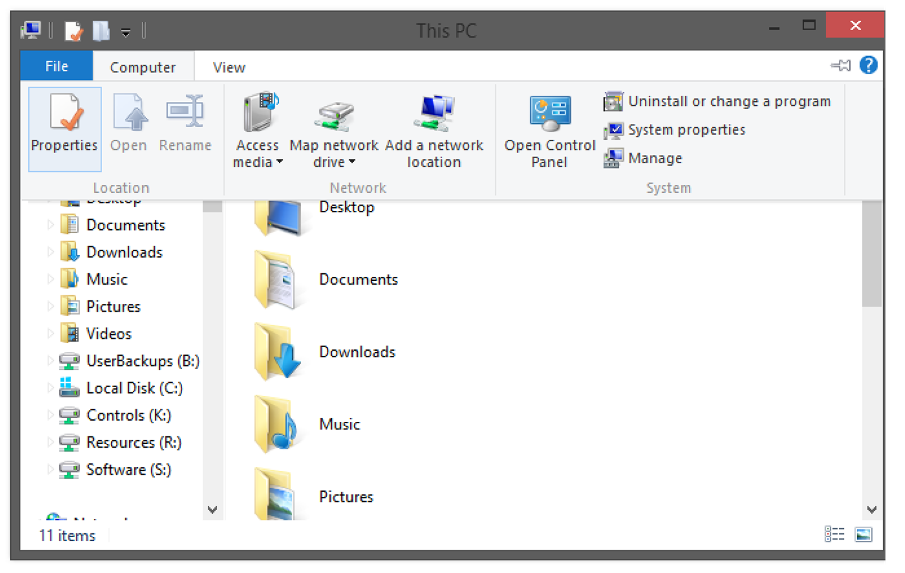
Adding Node.js to Path on Windows (1)
Go to "Computer" -> "Properties"

Slide 17
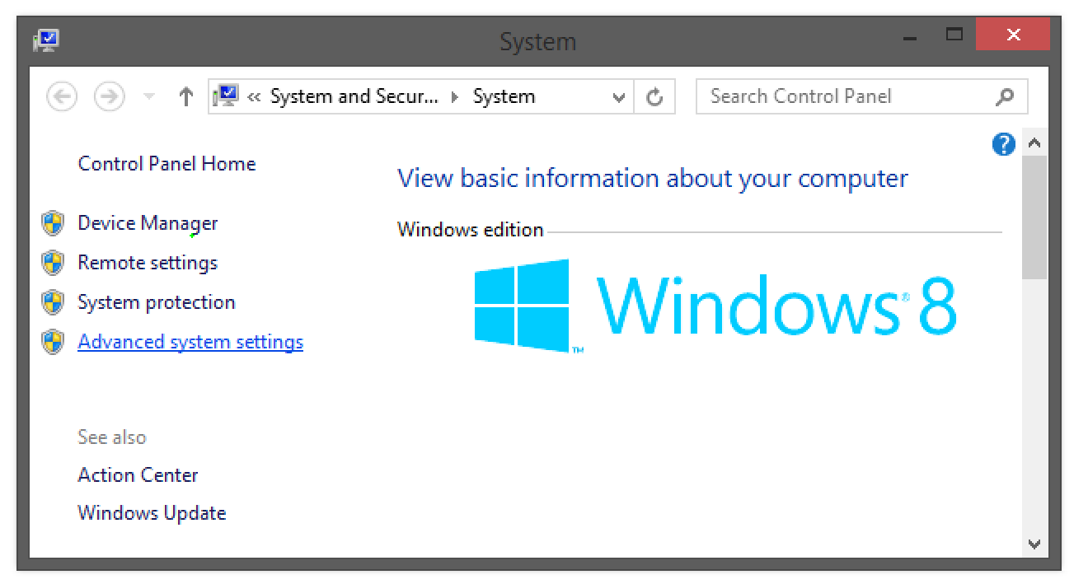
Adding Node.js to Path on Windows (2)
Go to "Advanced system settings"

Slide 18
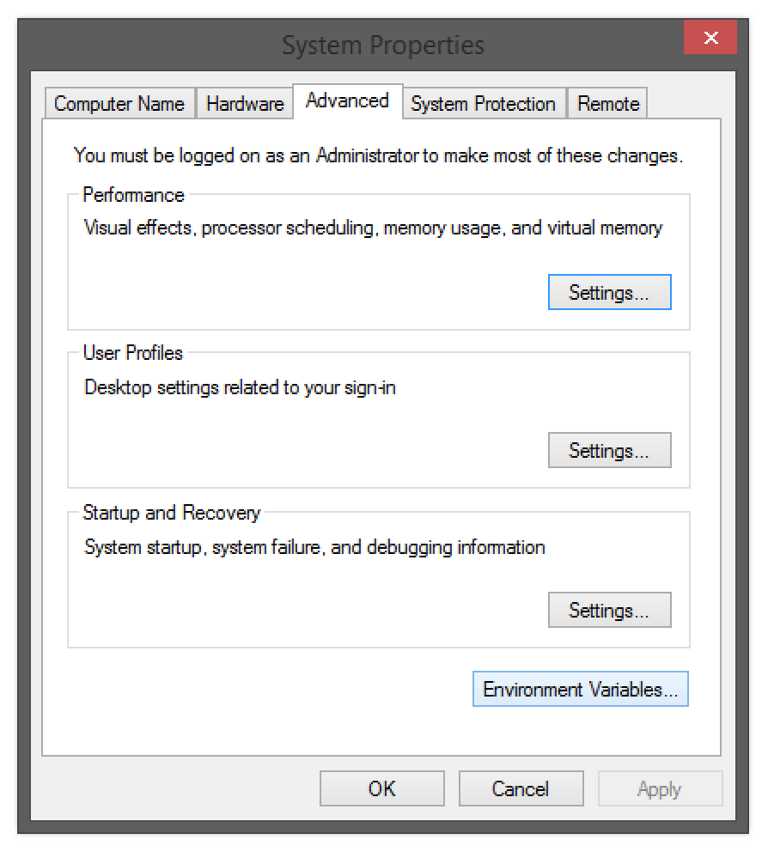
Adding Node.js to Path on Windows (3)
Go to "Advanced" -> "Environment Variables"

Slide 19
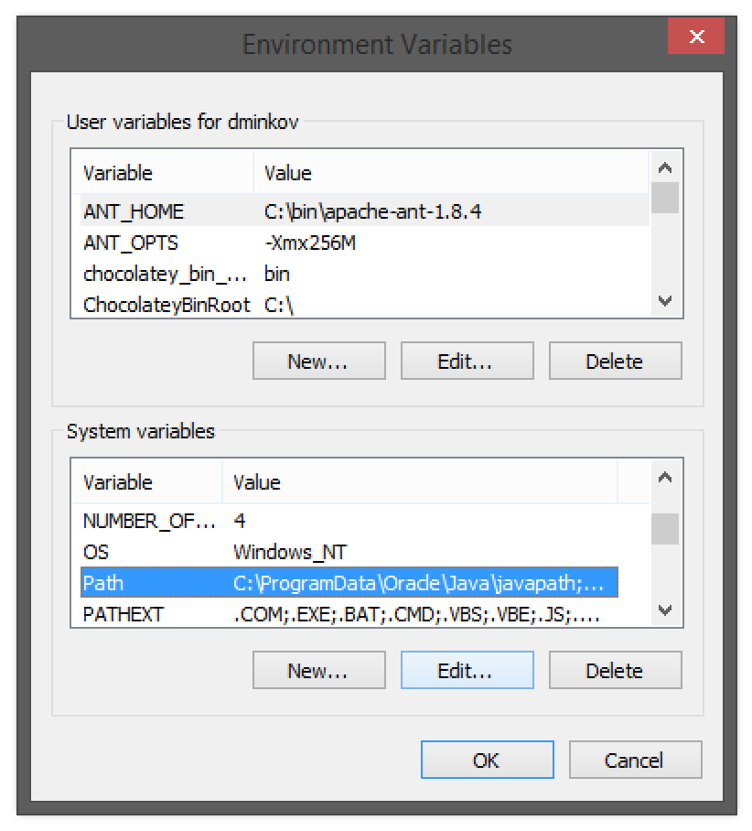
Adding Node.js to Path on Windows (4)
Go to "System Variables" -> "Path" -> "Edit"

Slide 20
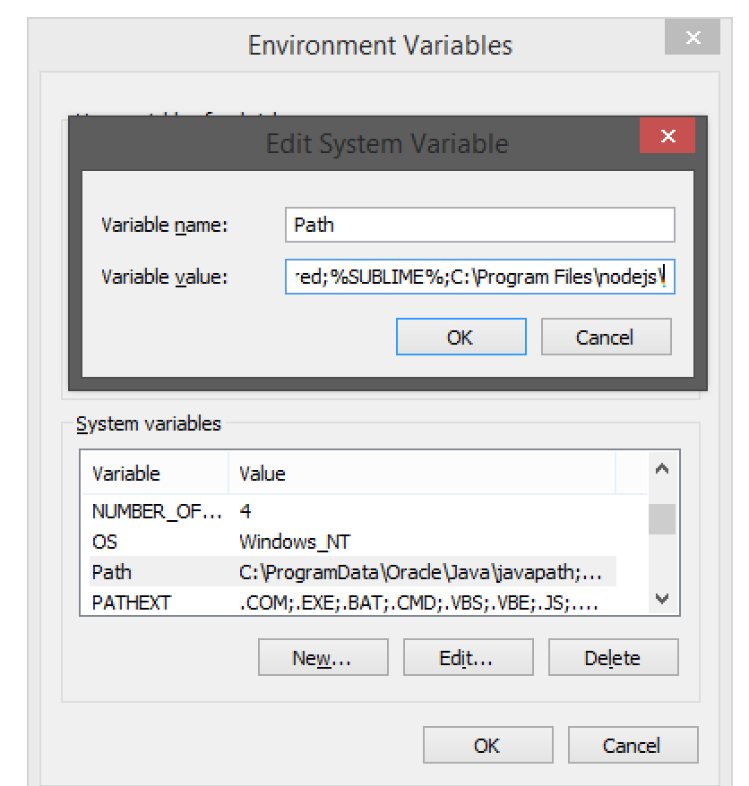
Adding Node.js to Path on Windows (5)
Add to the end:
;C:\Program Files\nodejs\
Adding Node.js To Path on Windows – Live Demo

Slide 21
Adding Node.js to Path on Linux and OS X
Open ~/.bashrc with admin sudo
Find the Node.js path
Usually it is "/usr/bin/node"
Add the Node.js path to ~/.bashrc
You have Node.js in the PATH
PATH=/usr/bin/node:$PATH
Adding Node.js to Path on OS X & Linux – Live Demo

Slide 22
JavaScript Syntax
The JavaScript syntax is similar to C#
Operators (+, *, =, !=, &&, ++, …)
Variables (typeless)
Conditional statements (if, else)
Loops (for, while)
Arrays (my_array[]) and associative arrays (my_array['abc'])
Functions (can return value)

Slide 23
Standard Popup Boxes
Alert box with text and [OK] button
Just a message shown in a dialog box:
Confirmation box
Contains text, [OK] button and [Cancel] button:
Prompt box
Contains text, input field with default value:
alert("Some text here");
confirm("Are you sure?");
prompt ("enter amount", 10);
Popup Boxes – Live Demo

Slide 24
Built-in Browser Objects
The browser provides some read-only data via:
window
The top node of the DOM tree
Represents the browser's window
document
holds information the current loaded document
screen
Holds the user’s display properties
browser
Holds information about the browser

Slide 25
DOM Hierarchy – Example
window
navigator
screen
document
history
location
form
form
button
form

Slide 26
Other JavaScript Objects

Slide 27
The Math Object
The Math object provides some mathematical functions
for (i=1; i<=20; i++) {
var x = Math.random();
x = 10*x + 1;
x = Math.floor(x);
document.write(
"Random number (" +
i + ") in range " +
"1..10 --> " + x +
"<br/>");
}

Slide 28
The Date Object
The Date object provides date / calendar functions
var now = new Date();
var result = "It is now " + now;
document.getElementById("timeField")
.innerText = result;
...
<p id="timeField"></p>

Slide 29
Timers: setTimeout()
Make something happen (once) after a fixed delay
var timer = setTimeout(bang, 5000);
5 seconds after this statement executes, this function is called
clearTimeout(timer);
Cancels the timer

Slide 30
Timers: setInterval()
Make something happen repeatedly at fixed intervals
var timer = setInterval(clock, 1000);
This function is called continuously per 1 second.
clearInterval(timer);
Stop the timer.

Slide 31
Timer – Example
<script type="text/javascript">
function timerFunc() {
let now = new Date();
let hour = now.getHours();
let min = now.getMinutes();
let sec = now.getSeconds();
document.getElementById("clock").value =
"" + hour + ":" + min + ":" + sec;
}
setInterval(timerFunc, 1000);
</script>
<input type="text" id="clock" />
Other JavaScript Objects – Live Demo

Slide 32
Debugging JavaScript
Modern browsers have JavaScript console where errors in scripts are reported
Errors may differ across browsers
Several tools to debug JavaScript
Microsoft Script Editor
Add-on for Internet Explorer
Supports breakpoints, watches
JavaScript statement debugger; opens the script editor

Slide 33
Firebug
Firebug – Firefox add-on for debugging JavaScript, CSS, HTML
Supports breakpoints, watches, JavaScript console editor
Very useful for CSS and HTML too
You can edit all the document real-time: CSS, HTML, etc
Shows how CSS rules apply to element
Shows Ajax requests and responses
Firebug is written mostly in JavaScript

Slide 34
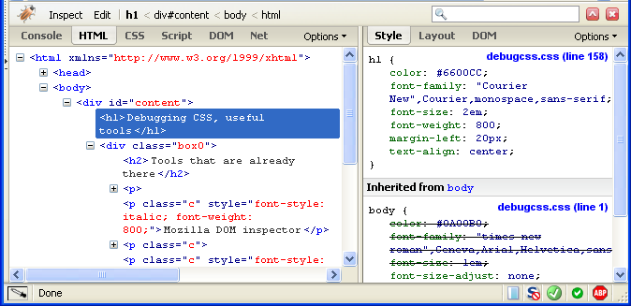
Firebug (2)
Debugging JS in the Browser – Live Demo

Slide 35
Debugging Node.js
JavaScript can also be debugged with Node.js:
Open Terminal/CMD
Run
In CMD/Terminal, navigate to the folder of the file to debug
Run in
A browser opens with the code, and it can be debugged
$ npm install –g node-inspector
$ node-debug FILE_TO_DEBUG
Debugging Node.js – Live Demo

Slide 36
JavaScript Console Object
The console object exists only if there is a debugging tool that supports it
Used to write log messages at runtime
Methods of the console object:
debug(message)
info(message)
log(message)
warn(message)
error(message)

